Slide 1
Cell Viability TRAMP-C1 Cells Treated with Curcumin, Isoliquiritigenin or Liquiritigenin (MTS)
Davit Sargsyan, 05/08/2016

Slide 2
Experiment Timeline
Wednesday 04/27/2016, 7 PM: 6 96-well plates were seeded with 10^3 TRAMP-C1 cells per well.
Friday 04/19/2016, 7 AM: 8 doses of CUR, ISO and LIQ were applied to the plates (100 μM starting dose, serial dilution 1/2) , columns 2 to 10; column 11 was left as a positive control 0.1% DMSO; edges were filled with medium.
Saturday – Monday (04/30/2016 to 05/02/2016): every day, for 3 consecutive days, two plates were taken out, MTS was applied to wells, and plate readings were taken 2 hours later.

Slide 3
Design and Analysis
Plates were analyzed at 24, 48 and 72 hours. Each plate was red twice. The results were consistent so only first readings were used in the analysis.
Data was analyzed using R 3.2.1. The estimates and plots were obtained using my robust 4-parameter curve fitting R package ‘ricf’.

Slide 4
Plate Layout

Slide 5
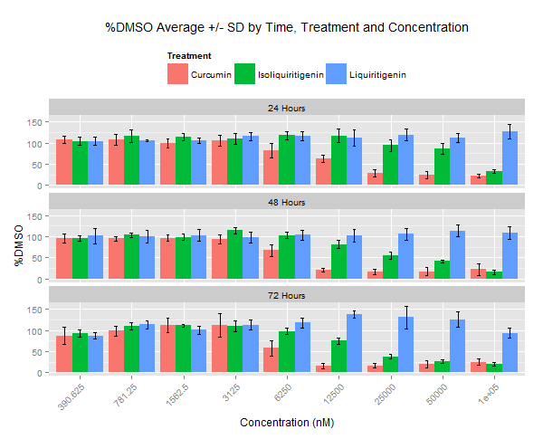
Barplot with Error Bars: %DMSO Average +/-SD

Slide 6
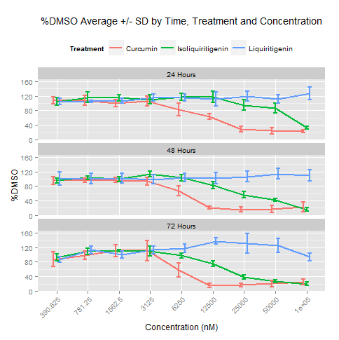
Lineplot with Error Bars: %DMSO Average +/-SD

Slide 7
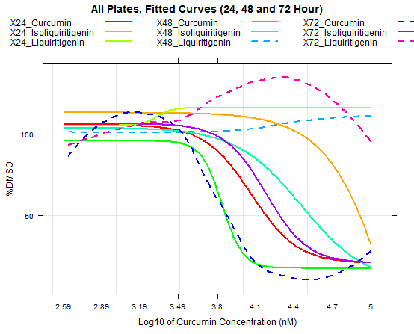
Curves Fitted to Read-outs

Slide 8
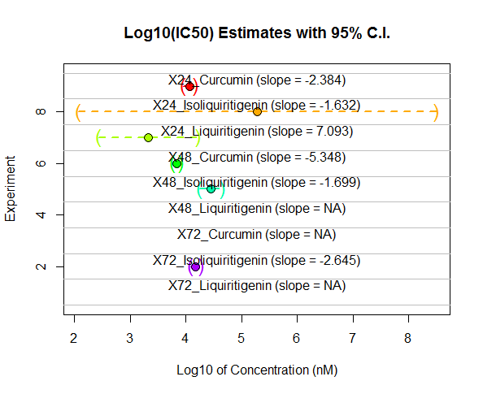

Slide 9
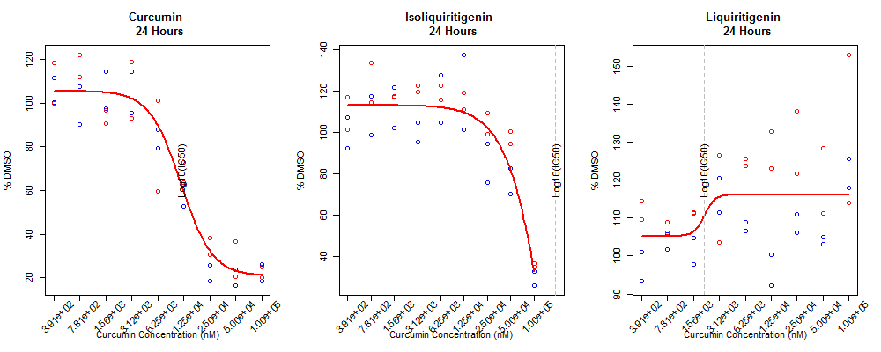
24 Hours

Slide 10
24 Hours

Slide 11
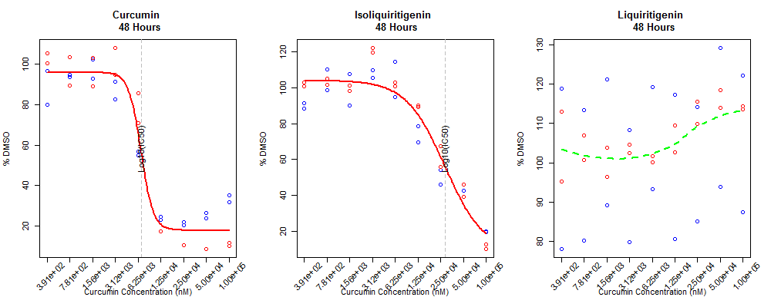
48 Hours

Slide 12
48 Hours

Slide 13
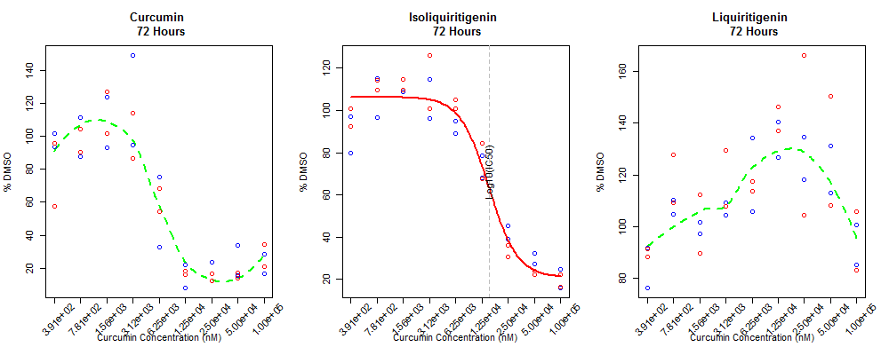
72 Hours

Slide 14
72 Hours

Slide 15
Discussion
Did not re-dose at 48 Hour (ran out of LIQ).
Hook effect was observed at low doses. A model that can describe the hook might be more appropriate, especially if the hook effect becomes more pronounced.
Smaller intervals between the doses can be beneficial as we can get smoother curves around IC50 values and decrease standard errors of the estimates.
Starting dose for ISO (100 μM) was too low. As a result, I missed bottom part of the curve. Starting concentration needs to be at least X16 of that (X20 = 2 mM)
Starting dose for LIQ (100 μM) was too low. As a result, I only observed the upper part of the curve. No estimate of starting concentration can be obtained from the data.

